Slide 1
Budweiser Case study
Data Scientist: Daanesh Ibrahim
Notes:
Hello and welcome to the Budweiser Beer study commissioned by you.
I am Daanesh Ibrahim and I will be going over our preliminary results with you.

Slide 2
Purpose
Determine if the Beers and Breweries data needs to be altered in anyway in order to properly analyze it.
Evaluate the Beers and Breweries data provided by you and determine trends or any additional information that would benefit where to release new products.
Focus on IBU and ABV trends by State as well as its relationship with IPAs and other Ales.
Notes:
The purpose of this study is to analyze and merge the 2 datasets provided by your company.
We need to make sure the data is consistent throughout so we do not harm the results of the study.
Determine any trends, focusing on the Alcohol by Volume and International Bitterness Unit and its relationships with specific states, as well as its relationship with India Pale Ales (IPA) and other Ales.

Slide 3
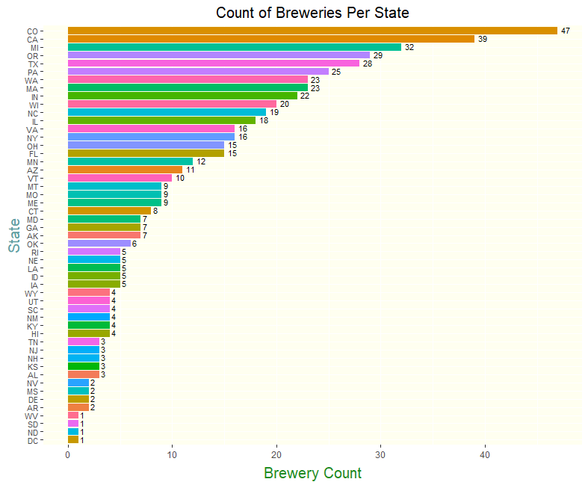
Breweries by State
Things to Note:
Colorado has highest the amount of breweries with 47
The following states are tied for having the lowest amount of breweries:
West Virginia
South Dakota
North Dakota
District of Columbia.
Notes:
Let us first examine the Breweries by State.
As you can see from the graph, Colorado has the highest number of breweries with 47, with California and Michigan not too far behind.
West Virginia, South Dakota, North Dakota, and the District of Columbia are tied with the least number of breweries with only 1

Slide 4
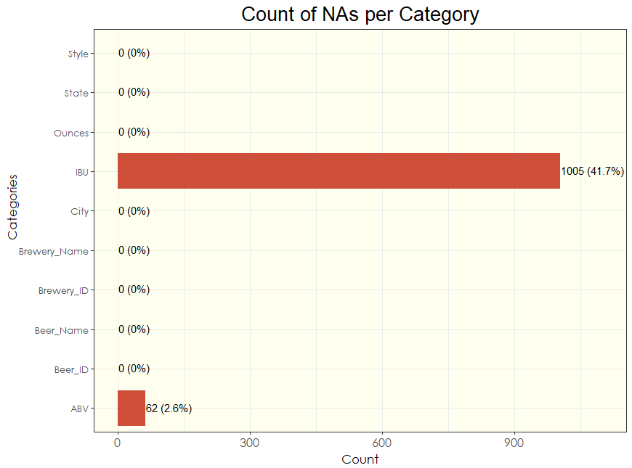
Count of Missing Data (NAs)
Of the 2,410 rows of data from the combined datasets:
IBU has 1,005 blanks (41.7%)
ABV has 62 blanks (2.6%)
Notes:
When we combined the datasets together, we created a single dataset with 2,410 rows of data.
However it was discovered that not all of the columns, or variables, have data within them.
Our IBU variable has 1,005 missing values which is about 42% of all potential IBU values we should have.
While not as high in count, our ABV variable has 62 missing values which equates to about 3% of the potential ABV values we should have.
We now had to make a decision. What should we do about these missing values? Omit them?
Well omitting complete rows of data could hurt the study as this would also remove other complete variables of data as well.

Slide 5
“Fill in the Blanks”
What should we replace the NA values with? Mean or Median?
Mean is a better measure of central tendency but is affected by potential outliers in the data.
Median is a better measure of the middle set of data and is resistant to outliers
Best way to look at the data is boxplots for ABV an IBU. This will tell us if there are outliers in the datasets in order to make our decision.
Notes:
So we must replace them. There are 2 clear choices in order to replace the values. The Mean or Median of the ABV and IBU values we actually do have.
Mean is a clear choice and a better measure of central tendency of data, however the downside of using Mean is that it can be influenced by outliers.
Median is a better measure of the middle of the data set and is less affected by outliers.
It becomes clear that this choice will depend on if the data sets have outliers present or not. We can view this information in a boxplot for each variable.

Slide 6
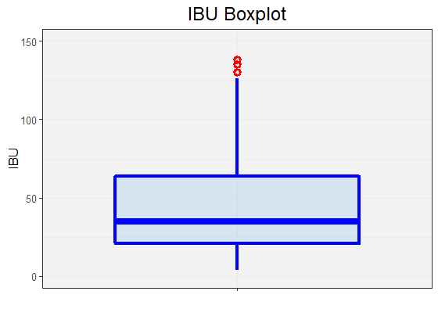
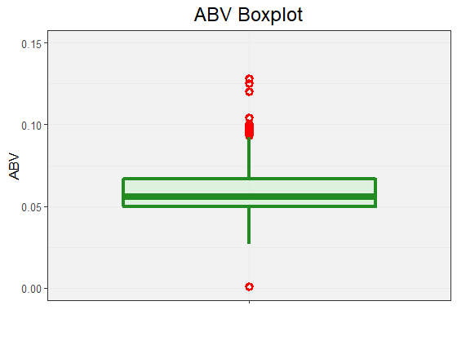
“Fill in the Blanks”
What should we replace the NA values with? Mean or Median?
Mean is a better measure of central tendency but is affected by potential outliers in the data.
Median is a better measure of the middle set of data and is resistant to outliers
Best way to look at the data is boxplots for ABV an IBU. This will tell us if there are outliers in the datasets in order to make our decision.
Notes:
Here we can see the boxplots for IBU and ABV specifically. The red circles in the graphs represent outliers in the data.
This is enough information to decide that we will use the Median as a our blank value replacements

Slide 7
“Fill in the Blanks”
NA Values for ABV and IBU are replaced by the respective median value for that state.
For states with no values for ABV and IBU, we will use the nationwide median values.
The only state that has only NAs was South Dakota for their IBU values. Therefore the national median of 35 was applied to their IBU values.
Notes:
We will use each respective State’s Median values for ABV and IBU in order to replace the missing values in those states.
This should ensure that our analysis by state won’t be affected by these replacement values, as they are being replaced with their own medians.
There is one state that had no values for IBU, so to fix that we have replaced these values with the National Median of IBU which is 35

Slide 8
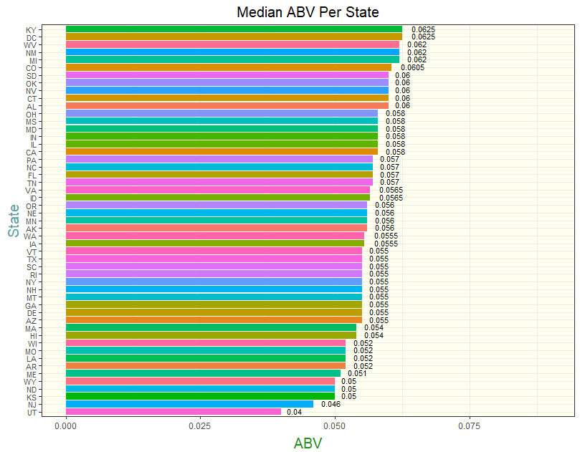
Median ABV Per State
Kentucky and District of Columbia are tied with the highest median ABV (0.625).
Utah has the lowest median ABV out of all of the states (0.04).
Notes:
Now we can begin to do some analysis on these values.
Since we have already determined that the values have outliers present, we will use Median as a way to analyze this data going forward.
Looking at the chart, we can see that the States with the highest Median ABV are Kentucky and District of Colombia.
The lowest median ABV is Utah, which makes sense since Utah has laws restricting stores to only sell packaged beer up to 5.0% ABV.
Beer containing alcohol greater than this amount (as well as liquor and wine) can only be sold at state-controlled liquor stores.

Slide 9
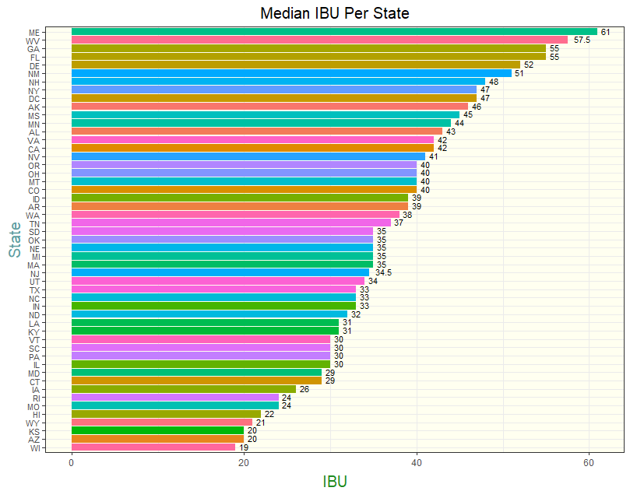
Median IBU Per State
Maine has the highest median IBU (61).
Wisconsin has the lowest median IBU (19).
Notes:
Now turning our attention to the Median IBU per state, we see that Maine has the highest value in this category.
Wisconsin has the lowest Median IBU, with Kansas and Arizona not too far behind.

Slide 10
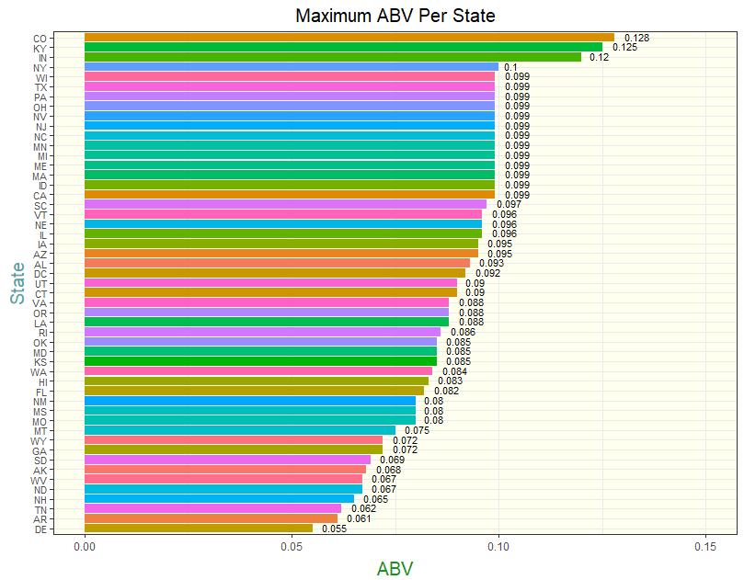
Maximum ABV Per State
Colorado has the highest maximum ABV out of all of the states with 0.128
Delaware has the lowest maximum ABV out of all of the states (0.055).
Notes:
It can be helpful to look at the extreme values for each state as well.
Looking at the chart we can see that Colorado possesses the highest ABV in a beer at 12.8%. That beer if you’re curious is “Lee Hill Series Vol. 5 - Belgian Style Quadrupel Ale.”
Delaware has the lowest Maximum ABV amongst all the states at only 5.5%

Slide 11
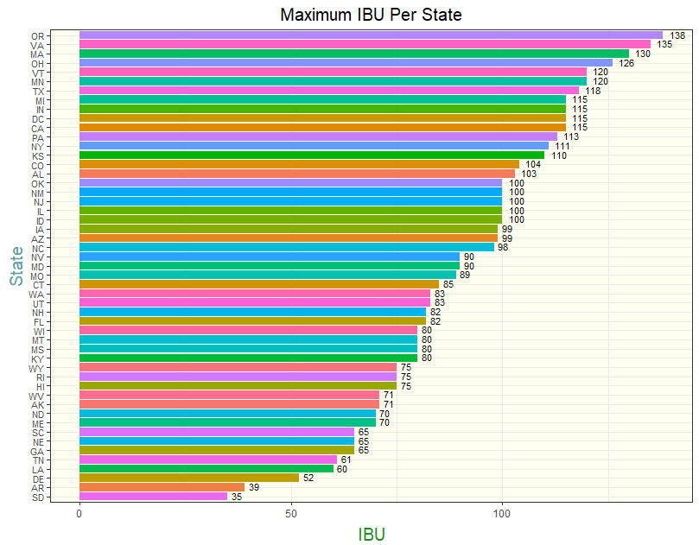
Maximum IBU Per State
Oregon has the highest maximum IBU with 138.
Arkansas has the lowest maximum IBU with 39 on this list (South Dakota is using the national median).
Notes:
Turning our attention to the Maximum IBU per State, we see that Oregon possess the highest value out of all the States at 138. This beer is “Bitter Bitch Imperial IPA”, a fitting name it seems.
The lowest maximum IBU on the chart is South Dakota, however we determined that South Dakota had all of their IBU values replaced with the national median of 35.
It is a coincidence that this happens to be the lowest maximum on this list, however since we know this information we can omit this and go to the next lowest maximum IBU which is in Arkansas

Slide 12
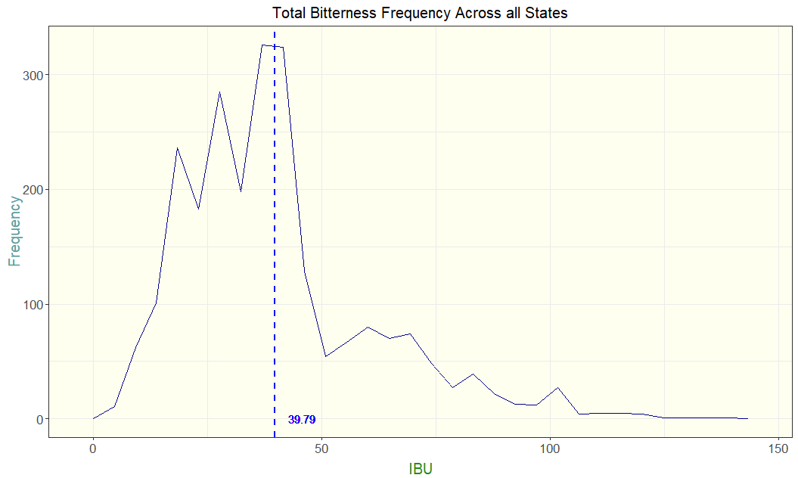
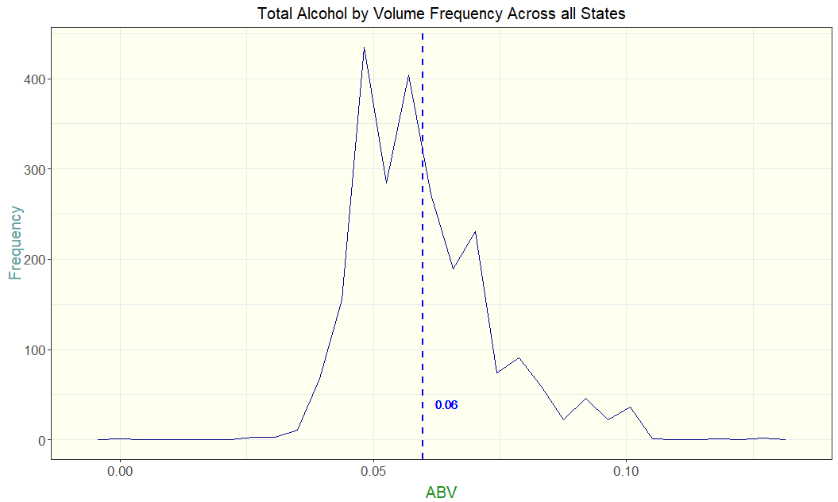
Summary Statistics
Frequency Distributions show us our counts of ABV and IBU across all states.
The mean of IBU is near the peak of the highest count of IBU among all states.
The mean of ABV is further from the highest count of ABV among all states. This tells us there are more outliers for ABV skewing the mean that may not be in line with the total counts of ABV.
Notes:
Let us now turn our attention to The Frequency Distributions of ABV and IBU. This will show us the counts of ABV and IBU values across all of the states.
By plotting the mean as a dotted line going down the chart, we can see how these frequencies relate to the average ABV and IBU.
Looking at the IBU chart, the highest frequency IBU is near the plotted mean IBU. This tells us the data is a fairly symmetrical distribution.
The ABV chart however shows the highest frequency ABV is more than 1% lesser than the mean ABV. We can infer from this that there are a considerable amount more outliers that are skewing the mean to be higher.

Slide 13
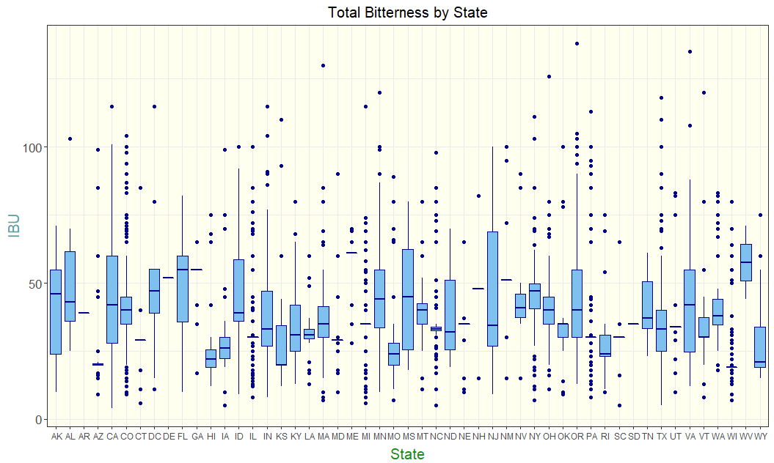
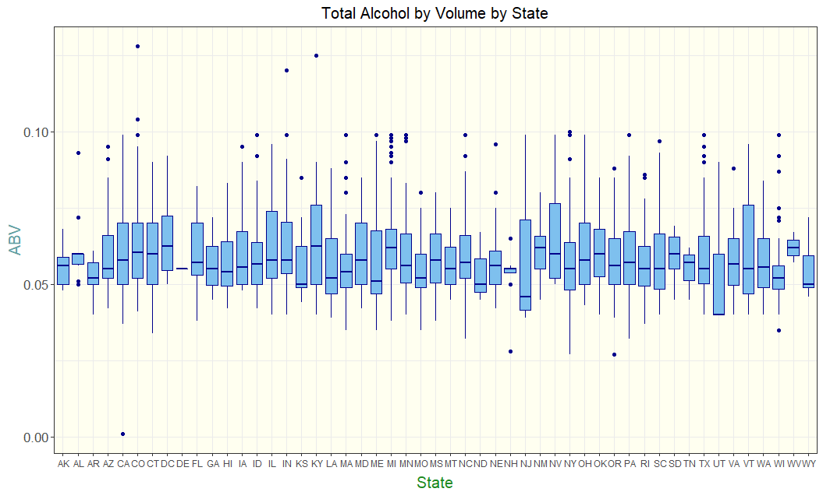
Summary Statistics
Boxplots show us our data summaries of ABV and IBU for each state.
IBU for California seems to be the most uniform across the state with the median being between the quartiles evenly and only one outlier
Though Colorado has the highest value alcohol by volume, this might be considered an outlier and should be taken into account when figuring out where to release products first with high ABV. Kentucky might be a better state to release a higher AVB product.
Notes:
Let us now look at boxplots for IBU and ABV among each state.
If we look at California IBU, we can see it appears to be the most evenly distributed amongst all the states.
We determine this by seeing how the median (center line of the box) relates to the quartiles (edges of the box) with only one outlier present.
Looking at the ABV boxplots, we already determined that Colorado had the beer with the highest ABV. We can see that on this chart, however it is shown as an outlier to the rest of Colorado’s ABV data.
We need to take this into account when determining where to release products higher in ABV.
Perhaps Kentucky might be a better choice since it is evenly distributed with a higher median than Colorado, while also still possessing a beer that is the second highest ABV amongst all states.

Slide 14
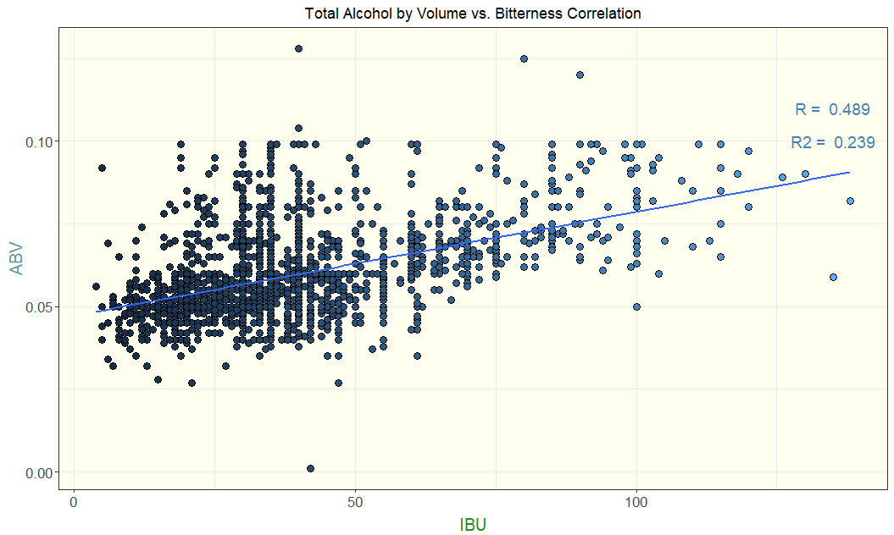
ABV vs IBU
Scatterplot of ABV vs IBU. Is there a relationship?
There is a positive relationship between the two variables
The correlation is 0.489, corresponding with a moderate relationship between ABV and IBU.
The coefficient of determination, or R², tells us that 23.9% of the variation in ABV values can be determined by variation of IBU values in this model.
Notes:
Now we wanted to determine if ABV and IBU had a relationship with one another. This could help us determine the correct scale of ABV and IBU within future products.
We can see that there is a positive relationship between the two values. The relationship strength is moderate.
Judging the model itself, we only have 23.9% confidence that any variation of ABV can be estimated by the variation of IBU.

Slide 15
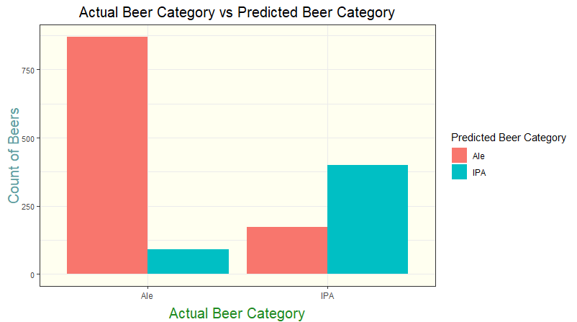
KNN
How well does ABV and IBU relate to IPAs and other Ales?
According to the data, we can successfully use the KNN model to correctly predict whether a beer is an Ale or IPA based only on their ABV and IBU 80% of the time.
We have a higher success rate predicting Ales (88.1%) vs IPAs (67.1%)
This is most likely due to the fact that IPAs are made with varying amounts of hops, malt, and alcohol content while Ales are more consistent with their ingredients.
Notes:
While the relationship between ABV and IBU was not as strong as we hoped, we can still use ABV and IBU to see what type of relationship they have with specific beer styles – specifically IPAs and other Ales.
This proved to be fairly successful, with the model being able to successfully predict whether a beer was an IPA or Ale 80% of the time.
Digging a little deeper, we were able to see that the model had a higher success rate with predicting Ales (88%) rather that IPAs (67%).
We do not know for certain, but our guess is that IPAs have more variation of the hops, malt, and alcohol content they use in their products.
Ales on the other hand are much more consistent with their ingredients.

Slide 16
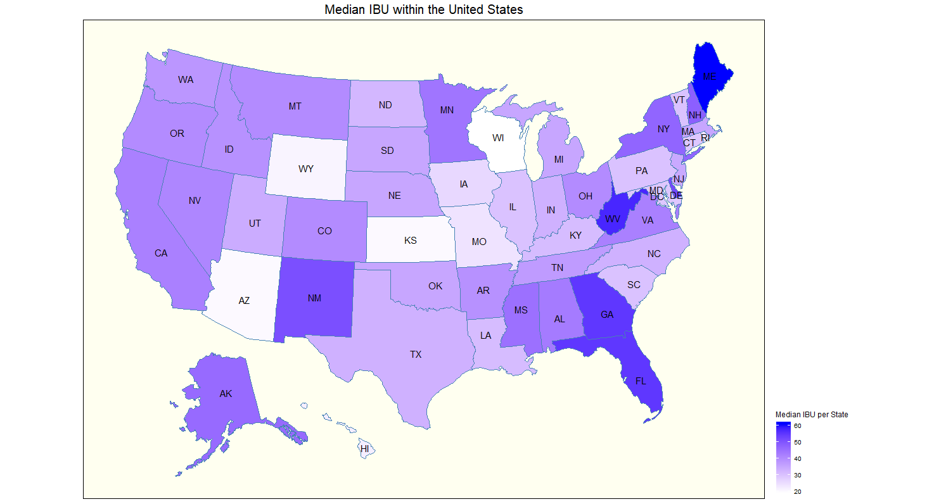
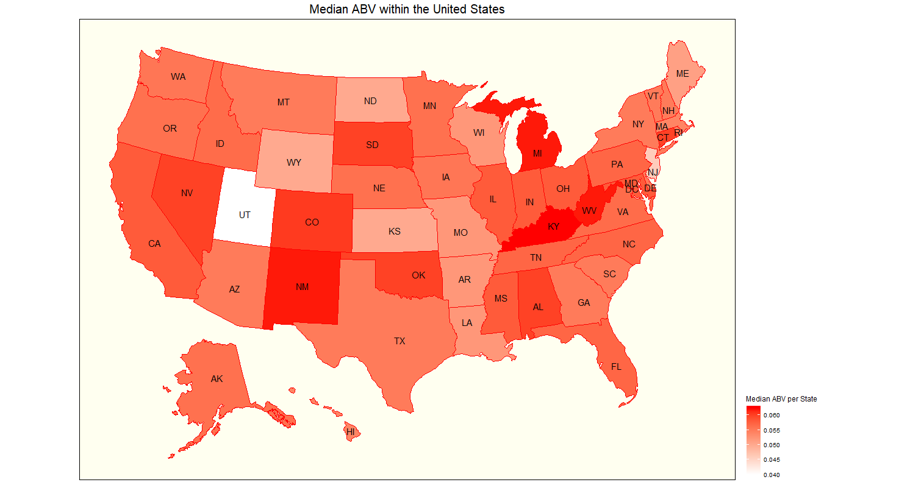
Additional Data
Can we use view median IBU and ABV in a more efficient way?
Looking at the median IBU and ABV trends by region of the United States could be beneficial on where to release certain types beer.
Higher IBU beers would benefit from being released in the Southeast corner of the country (Florida and Georgia region)
Higher ABV beers would benefit from being released not only in Kentucky, which is the highest, but also it’s bordering state of West Virginia as well.
Notes:
Yes, we have focused on the Medians of ABV and IBU amongst the states already.
However I believe there is an added benefit of viewing these medians on a map in order to see if there are trends your company can take advantage of.
You don’t just have to release a new product in a specific state, but perhaps instead can release to larger market.
Looking at this heatmap of the United States, we can see patterns of higher or lower ABV and IBU values across states that even share borders. This makes potential release markets much larger, or at east a good plan in where to release a product next after it’s initial release.
It seems that for beers higher in IBU, it could be better to release in the state cluster of Florida and Georgia at the same time.
For beers higher in ABV, we already determined that Kentucky would be a good State to release them in. But West Virginia is also quite high on the list and shares a border with Kentucky. Releasing a higher ABV product in these 2 states should be considered over only releasing in a single state.

Slide 17
Takeaways
Median is a better way to judge data like ABV and IBU that contain outliers as it is resistant to being affected by them.
ABV and IBU are more consistent with Other Ales than they are with IPAs.
Focus on IBU and ABV trends by State as well as the trends by adjacent states.
Notes:
To summarize some of our findings we have shared with you today,
The Median was a better way to summarize the dataset values for ABV and IBU as it is more resistant to outliers which were present for both variables.
ABV and IBU are more consistent with other Ales than they are with IPAs
It could be more beneficial to view IBU and ABV trends in state clusters than just individually so you can release new products in larger markets initially.

Slide 18
Questions

